Slide 1
Harmony in sight or how vowel harmony modulates visual word recognition in Turkish
𐰽𐰑𐰯𐰖𐰴𐰽𐰯𐰽𐰑𐰴𐰖𐰣𐰯𐰽𐰑𐰯𐰴𐰯𐰖𐰍𐰣𐰺𐰤𐰀𐰀𐰆𐰣𐰋𐰀𐰾𐰓𐰯𐰚𐰾𐰘𐰏𐰦𐰯𐰠𐰚𐰏𐰾𐰚𐰾𐰯𐰯𐰴𐰯𐰀𐰠𐱁𐰴𐰀𐰠𐰇𐰀𐰯𐰯𐰚𐰴𐰆𐰞𐰀𐱁𐰾𐰇𐰠𐰯𐰀𐰚𐰯𐰆𐰴𐰍𐰀𐰞𐱁𐰾𐰀𐰢𐰯𐰚𐰡𐰯𐰚𐰏𐰚𐰢𐰓𐰯𐰚𐰚𐰏𐰯𐰓𐰚𐰓𐰚𐰼𐰘𐰏𐰤𐰀𐰠𐰚𐰤𐰀𐰼𐰚𐰲𐰋𐰢𐰍𐰃𐰀𐰺𐰆𐰉𐰲𐰴𐱃𐰉𐰆𐰃𐰺𐰏𐰀𐰘𐰚𐰍𐰃𐱃𐰆𐰆𐰀𐰯𐰘𐰚𐰠𐰤𐰚𐰼𐰏𐰴𐰃𐰞𐰖𐰴𐰆𐰀𐰯𐰖𐰆𐰞𐰴𐰭𐰺𐰴𐰃𐰴𐰞3𐰆𐰆𐰼𐰀𐰴𐰘𐰠𐰚𐰢𐰯𐰤𐰏𐰼𐰴𐰃𐰖𐰴𐰆𐰆𐰀𐰴𐰘𐰠𐰯𐰚𐰤𐰴𐰃𐰺𐱃𐰆𐰆𐰀𐰘𐰠𐰯
Zeynep G. Özkan ¹, Berceste Özdemir ², Pablo Gómez ³, Manuel Perea ¹
Universitat de València
Üsküdar Üniversitesi
Skidmore College
Notes:
Hello everyone Im zeynep özkan and today I would like to talk about vowel harmony in Turkish.

Slide 2
Vowel Harmony
𐰽𐰑𐰯𐰖𐰴𐰽𐰯𐰽𐰑𐰴𐰖𐰣𐰯𐰽𐰑𐰯𐰴𐰯𐰖𐰍𐰣𐰺𐰤𐰀𐰀𐰆𐰣𐰋𐰀𐰾𐰓𐰯𐰚𐰾𐰘𐰏𐰦𐰯𐰠𐰚𐰏𐰾𐰚𐰾𐰯𐰯𐰴𐰯𐰀𐰠𐱁𐰴𐰀𐰠𐰇𐰀𐰯𐰯𐰚𐰴𐰆𐰞𐰀𐱁𐰾𐰇𐰠𐰯𐰀𐰚𐰯𐰆𐰴𐰍𐰀𐰞𐱁𐰾𐰀𐰢𐰯𐰚𐰡𐰯𐰚𐰏𐰚𐰢𐰓𐰯𐰚𐰚𐰏𐰯𐰓𐰚𐰓𐰚𐰼𐰘𐰏𐰤𐰀𐰠𐰚𐰤𐰀𐰼𐰚𐰲𐰋𐰢𐰍𐰃𐰀𐰺𐰆𐰉𐰲𐰴𐱃𐰉𐰆𐰃𐰺𐰏𐰀𐰘𐰚𐰍𐰃𐱃𐰆𐰆𐰀𐰯𐰘𐰚𐰠𐰤𐰚𐰼𐰏𐰴𐰃𐰞𐰖𐰴𐰆𐰀𐰯𐰖𐰆𐰞𐰴𐰭𐰺𐰴𐰃𐰴𐰞3𐰆𐰆𐰼𐰀𐰴𐰘𐰠𐰚𐰢𐰯𐰤𐰏𐰼𐰴𐰃𐰖𐰴𐰆𐰆𐰀𐰴𐰘𐰠𐰯𐰚𐰤𐰴𐰃𐰺𐱃𐰆𐰆𐰀𐰘𐰠𐰯
It is a phonological phenomenon that occurs in several families of languages (e.g., Altaic languages [Turkish, Mongolian], Uralic languages [Finnish, Hungarian], and others).
In these languages, vowels within a word share certain phonetic features (frontness vs. backness harmony, roundness harmony, among others).
It may help speech production by having consistent articulatory gestures.
It also affects morphological processes (e.g., suffixes) and word formation.
Notes:
Vowel harmony is a phonological phenomenon. This occurs when vowels within a word share certain phonetic features. There are different kinds of harmony types like frontness vs backness harmony or roundness harmony in this presentation I will focus on frontness and backness vowel harmony. Vowel harmony occurs in several families of languages. It helps speech production as it facilitates pronunciation. And also it affects morphological processes such as suffix formation.

Slide 3
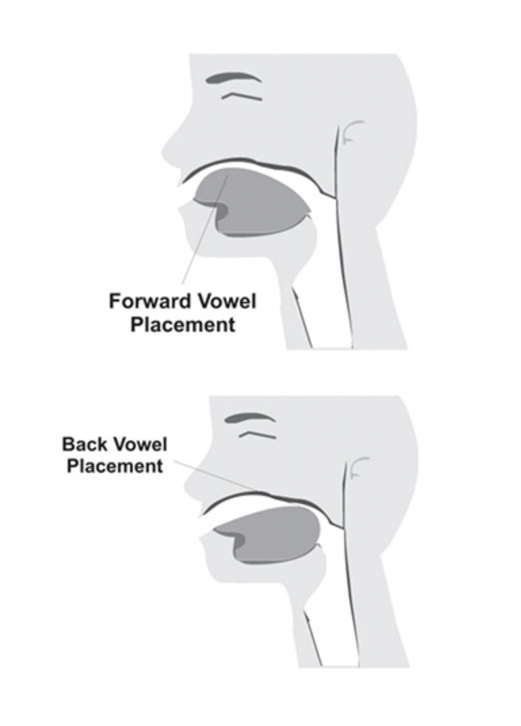
Vowel Harmony in Turkish
𐰽𐰑𐰯𐰖𐰴𐰽𐰯𐰽𐰑𐰴𐰖𐰣𐰯𐰽𐰑𐰯𐰴𐰯𐰖𐰍𐰣𐰺𐰤𐰀𐰀𐰆𐰣𐰋𐰀𐰾𐰓𐰯𐰚𐰾𐰘𐰏𐰦𐰯𐰠𐰚𐰏𐰾𐰚𐰾𐰯𐰯𐰴𐰯𐰀𐰠𐱁𐰴𐰀𐰠𐰇𐰀𐰯𐰯𐰚𐰴𐰆𐰞𐰀𐱁𐰾𐰇𐰠𐰯𐰀𐰚𐰯𐰆𐰴𐰍𐰀𐰞𐱁𐰾𐰀𐰢𐰯𐰚𐰡𐰯𐰚𐰏𐰚𐰢𐰓𐰯𐰚𐰚𐰏𐰯𐰓𐰚𐰓𐰚𐰼𐰘𐰏𐰤𐰀𐰠𐰚𐰤𐰀𐰼𐰚𐰲𐰋𐰢𐰍𐰃𐰀𐰺𐰆𐰉𐰲𐰴𐱃𐰉𐰆𐰃𐰺𐰏𐰀𐰘𐰚𐰍𐰃𐱃𐰆𐰆𐰀𐰯𐰘𐰚𐰠𐰤𐰚𐰼𐰏𐰴𐰃𐰞𐰖𐰴𐰆𐰀𐰯𐰖𐰆𐰞𐰴𐰭𐰺𐰴𐰃𐰴𐰞3𐰆𐰆𐰼𐰀𐰴𐰘𐰠𐰚𐰢𐰯𐰤𐰏𐰼𐰴𐰃𐰖𐰴𐰆𐰆𐰀𐰴𐰘𐰠𐰯𐰚𐰤𐰴𐰃𐰺𐱃𐰆𐰆𐰀𐰘𐰠𐰯
Frontness and backness harmony:
Words contain either front vowels or back vowels.
Turkish Vowels
Front Back
e (/e/)
a (/a/)
i (/i/)
ı (/ɯ/)
ü (/y/)
u (/u/)
ö (/ø/)
o (/o/)
güven [trust]
kabul [accept]
Notes:
In front back harmony, words should contain only front or back vowels.

Slide 4
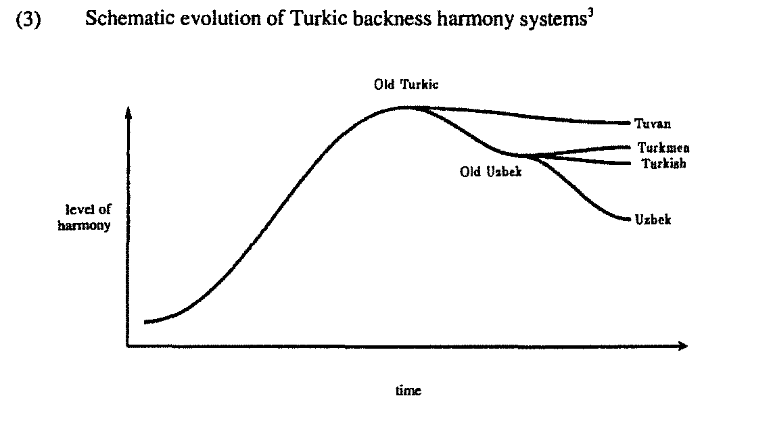
Vowel Harmony in Turkish
𐰽𐰑𐰯𐰖𐰴𐰽𐰯𐰽𐰑𐰴𐰖𐰣𐰯𐰽𐰑𐰯𐰴𐰯𐰖𐰍𐰣𐰺𐰤𐰀𐰀𐰆𐰣𐰋𐰀𐰾𐰓𐰯𐰚𐰾𐰘𐰏𐰦𐰯𐰠𐰚𐰏𐰾𐰚𐰾𐰯𐰯𐰴𐰯𐰀𐰠𐱁𐰴𐰀𐰠𐰇𐰀𐰯𐰯𐰚𐰴𐰆𐰞𐰀𐱁𐰾𐰇𐰠𐰯𐰀𐰚𐰯𐰆𐰴𐰍𐰀𐰞𐱁𐰾𐰀𐰢𐰯𐰚𐰡𐰯𐰚𐰏𐰚𐰢𐰓𐰯𐰚𐰚𐰏𐰯𐰓𐰚𐰓𐰚𐰼𐰘𐰏𐰤𐰀𐰠𐰚𐰤𐰀𐰼𐰚𐰲𐰋𐰢𐰍𐰃𐰀𐰺𐰆𐰉𐰲𐰴𐱃𐰉𐰆𐰃𐰺𐰏𐰀𐰘𐰚𐰍𐰃𐱃𐰆𐰆𐰀𐰯𐰘𐰚𐰠𐰤𐰚𐰼𐰏𐰴𐰃𐰞𐰖𐰴𐰆𐰀𐰯𐰖𐰆𐰞𐰴𐰭𐰺𐰴𐰃𐰴𐰞3𐰆𐰆𐰼𐰀𐰴𐰘𐰠𐰚𐰢𐰯𐰤𐰏𐰼𐰴𐰃𐰖𐰴𐰆𐰆𐰀𐰴𐰘𐰠𐰯𐰚𐰤𐰴𐰃𐰺𐱃𐰆𐰆𐰀𐰘𐰠𐰯
Old Turkic had full consistent word harmony. Modern Turkish still keeps 75% of this pattern despite cultural influences over time.
Mucize [miracle] Arabic
Egzotik [exotic] French
Efsane [legend] Persian
Harrison et al. (2002)
Notes:
While all words in old Turkic were harmonious, with the influence of other cultures across time like Arabic, Persian, and, Western languages,the percentage of Vowel harmony reduced in most Turkic languages. Yet modern Turkish maintains a vowel harmony pattern in approximately 75% of its vocabulary.

Slide 5
Vowel Harmony and speech segmentation
𐰽𐰑𐰯𐰖𐰴𐰽𐰯𐰽𐰑𐰴𐰖𐰣𐰯𐰽𐰑𐰯𐰴𐰯𐰖𐰍𐰣𐰺𐰤𐰀𐰀𐰆𐰣𐰋𐰀𐰾𐰓𐰯𐰚𐰾𐰘𐰏𐰦𐰯𐰠𐰚𐰏𐰾𐰚𐰾𐰯𐰯𐰴𐰯𐰀𐰠𐱁𐰴𐰀𐰠𐰇𐰀𐰯𐰯𐰚𐰴𐰆𐰞𐰀𐱁𐰾𐰇𐰠𐰯𐰀𐰚𐰯𐰆𐰴𐰍𐰀𐰞𐱁𐰾𐰀𐰢𐰯𐰚𐰡𐰯𐰚𐰏𐰚𐰢𐰓𐰯𐰚𐰚𐰏𐰯𐰓𐰚𐰓𐰚𐰼𐰘𐰏𐰤𐰀𐰠𐰚𐰤𐰀𐰼𐰚𐰲𐰋𐰢𐰍𐰃𐰀𐰺𐰆𐰉𐰲𐰴𐱃𐰉𐰆𐰃𐰺𐰏𐰀𐰘𐰚𐰍𐰃𐱃𐰆𐰆𐰀𐰯𐰘𐰚𐰠𐰤𐰚𐰼𐰏𐰴𐰃𐰞𐰖𐰴𐰆𐰀𐰯𐰖𐰆𐰞𐰴𐰭𐰺𐰴𐰃𐰴𐰞3𐰆𐰆𐰼𐰀𐰴𐰘𐰠𐰚𐰢𐰯𐰤𐰏𐰼𐰴𐰃𐰖𐰴𐰆𐰆𐰀𐰴𐰘𐰠𐰯𐰚𐰤𐰴𐰃𐰺𐱃𐰆𐰆𐰀𐰘𐰠𐰯
Vowel harmony facilitates speech segmentation in infants and adults.
7-month-old infants from UK can detect vowel harmony patterns without language exposure.
Vowel harmony patterns aid infants in segmenting continuous speech into proto-word forms (Mintz et al., 2018).
In adults of languages with vowel harmony:
They use vowel harmony as a cue when segmenting words in disharmonious spoken nonword strings (Suomi et al., 1997; Vroomen et al., 1998)
Notes:
As Vowel harmony is an phonological phenomonen, it helps speech segmentation in adulst and infants.
7-month-old infants who have never been exposed to a language with vowel harmony can detect the harmony patterns. Also when no other cues to word boundaries are present, infants segment word forms from continuous speech based on harmony patterns.
And as expected adults from vowel harmony languages can use harmony patterns as a cue to segment words in disharmonious spoken nonword string.

Slide 6
What about the visual domain?
𐰽𐰑𐰯𐰖𐰴𐰽𐰯𐰽𐰑𐰴𐰖𐰣𐰯𐰽𐰑𐰯𐰴𐰯𐰖𐰍𐰣𐰺𐰤𐰀𐰀𐰆𐰣𐰋𐰀𐰾𐰓𐰯𐰚𐰾𐰘𐰏𐰦𐰯𐰠𐰚𐰏𐰾𐰚𐰾𐰯𐰯𐰴𐰯𐰀𐰠𐱁𐰴𐰀𐰠𐰇𐰀𐰯𐰯𐰚𐰴𐰆𐰞𐰀𐱁𐰾𐰇𐰠𐰯𐰀𐰚𐰯𐰆𐰴𐰍𐰀𐰞𐱁𐰾𐰀𐰢𐰯𐰚𐰡𐰯𐰚𐰏𐰚𐰢𐰓𐰯𐰚𐰚𐰏𐰯𐰓𐰚𐰓𐰚𐰼𐰘𐰏𐰤𐰀𐰠𐰚𐰤𐰀𐰼𐰚𐰲𐰋𐰢𐰍𐰃𐰀𐰺𐰆𐰉𐰲𐰴𐱃𐰉𐰆𐰃𐰺𐰏𐰀𐰘𐰚𐰍𐰃𐱃𐰆𐰆𐰀𐰯𐰘𐰚𐰠𐰤𐰚𐰼𐰏𐰴𐰃𐰞𐰖𐰴𐰆𐰀𐰯𐰖𐰆𐰞𐰴𐰭𐰺𐰴𐰃𐰴𐰞3𐰆𐰆𐰼𐰀𐰴𐰘𐰠𐰚𐰢𐰯𐰤𐰏𐰼𐰴𐰃𐰖𐰴𐰆𐰆𐰀𐰴𐰘𐰠𐰯𐰚𐰤𐰴𐰃𐰺𐱃𐰆𐰆𐰀𐰘𐰠𐰯
Notes:
Okay we went over the auditory domain but what about the visual domain?

Slide 7
Vowel Harmony when reading compounds
𐰽𐰑𐰯𐰖𐰴𐰽𐰯𐰽𐰑𐰴𐰖𐰣𐰯𐰽𐰑𐰯𐰴𐰯𐰖𐰍𐰣𐰺𐰤𐰀𐰀𐰆𐰣𐰋𐰀𐰾𐰓𐰯𐰚𐰾𐰘𐰏𐰦𐰯𐰠𐰚𐰏𐰾𐰚𐰾𐰯𐰯𐰴𐰯𐰀𐰠𐱁𐰴𐰀𐰠𐰇𐰀𐰯𐰯𐰚𐰴𐰆𐰞𐰀𐱁𐰾𐰇𐰠𐰯𐰀𐰚𐰯𐰆𐰴𐰍𐰀𐰞𐱁𐰾𐰀𐰢𐰯𐰚𐰡𐰯𐰚𐰏𐰚𐰢𐰓𐰯𐰚𐰚𐰏𐰯𐰓𐰚𐰓𐰚𐰼𐰘𐰏𐰤𐰀𐰠𐰚𐰤𐰀𐰼𐰚𐰲𐰋𐰢𐰍𐰃𐰀𐰺𐰆𐰉𐰲𐰴𐱃𐰉𐰆𐰃𐰺𐰏𐰀𐰘𐰚𐰍𐰃𐱃𐰆𐰆𐰀𐰯𐰘𐰚𐰠𐰤𐰚𐰼𐰏𐰴𐰃𐰞𐰖𐰴𐰆𐰀𐰯𐰖𐰆𐰞𐰴𐰭𐰺𐰴𐰃𐰴𐰞3𐰆𐰆𐰼𐰀𐰴𐰘𐰠𐰚𐰢𐰯𐰤𐰏𐰼𐰴𐰃𐰖𐰴𐰆𐰆𐰀𐰴𐰘𐰠𐰯𐰚𐰤𐰴𐰃𐰺𐱃𐰆𐰆𐰀𐰘𐰠𐰯
Bertram et al. (2004) investigated the effect of vowel harmony on the parsing of compound words in Finnish.
sähköasentaja [electricity expert]; disharmonious
satuolento [fairytale creature]; harmonious
They found shorter eye fixation times when the constituents of the compound word were harmonically dissonant.
Notes:
there is evidence that this phenomenon also affects visual domains. For example, in Finnish, which is also a language with vowel harmony, if the two words in the compound word are harmonically dissonant, the process of the compound is faster. This means that vowel harmony facilitates the segmentation of compound words and acts as a cue.

Slide 8
And what about the role of vowel harmony during visual word recognition?
𐰽𐰑𐰯𐰖𐰴𐰽𐰯𐰽𐰑𐰴𐰖𐰣𐰯𐰽𐰑𐰯𐰴𐰯𐰖𐰍𐰣𐰺𐰤𐰀𐰀𐰆𐰣𐰋𐰀𐰾𐰓𐰯𐰚𐰾𐰘𐰏𐰦𐰯𐰠𐰚𐰏𐰾𐰚𐰾𐰯𐰯𐰴𐰯𐰀𐰠𐱁𐰴𐰀𐰠𐰇𐰀𐰯𐰯𐰚𐰴𐰆𐰞𐰀𐱁𐰾𐰇𐰠𐰯𐰀𐰚𐰯𐰆𐰴𐰍𐰀𐰞𐱁𐰾𐰀𐰢𐰯𐰚𐰡𐰯𐰚𐰏𐰚𐰢𐰓𐰯𐰚𐰚𐰏𐰯𐰓𐰚𐰓𐰚𐰼𐰘𐰏𐰤𐰀𐰠𐰚𐰤𐰀𐰼𐰚𐰲𐰋𐰢𐰍𐰃𐰀𐰺𐰆𐰉𐰲𐰴𐱃𐰉𐰆𐰃𐰺𐰏𐰀𐰘𐰚𐰍𐰃𐱃𐰆𐰆𐰀𐰯𐰘𐰚𐰠𐰤𐰚𐰼𐰏𐰴𐰃𐰞𐰖𐰴𐰆𐰀𐰯𐰖𐰆𐰞𐰴𐰭𐰺𐰴𐰃𐰴𐰞3𐰆𐰆𐰼𐰀𐰴𐰘𐰠𐰚𐰢𐰯𐰤𐰏𐰼𐰴𐰃𐰖𐰴𐰆𐰆𐰀𐰴𐰘𐰠𐰯𐰚𐰤𐰴𐰃𐰺𐱃𐰆𐰆𐰀𐰘𐰠𐰯
Notes:
More specifically what about the role of vowel harmony during word recognition?

Slide 9
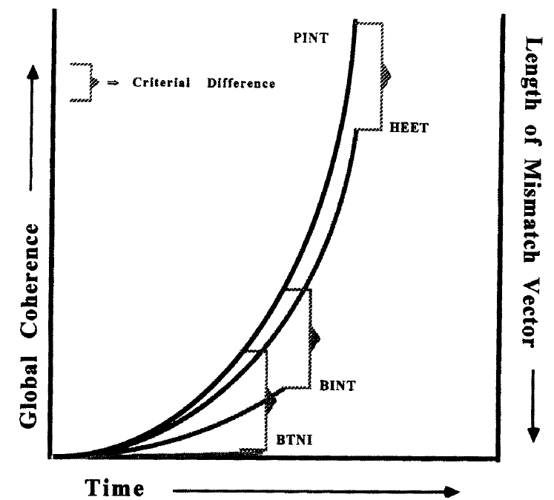
𐰽𐰑𐰯𐰖𐰴𐰽𐰯𐰽𐰑𐰴𐰖𐰣𐰯𐰽𐰑𐰯𐰴𐰯𐰖𐰍𐰣𐰺𐰤𐰀𐰀𐰆𐰣𐰋𐰀𐰾𐰓𐰯𐰚𐰾𐰘𐰏𐰦𐰯𐰠𐰚𐰏𐰾𐰚𐰾𐰯𐰯𐰴𐰯𐰀𐰠𐱁𐰴𐰀𐰠𐰇𐰀𐰯𐰯𐰚𐰴𐰆𐰞𐰀𐱁𐰾𐰇𐰠𐰯𐰀𐰚𐰯𐰆𐰴𐰍𐰀𐰞𐱁𐰾𐰀𐰢𐰯𐰚𐰡𐰯𐰚𐰏𐰚𐰢𐰓𐰯𐰚𐰚𐰏𐰯𐰓𐰚𐰓𐰚𐰼𐰘𐰏𐰤𐰀𐰠𐰚𐰤𐰀𐰼𐰚𐰲𐰋𐰢𐰍𐰃𐰀𐰺𐰆𐰉𐰲𐰴𐱃𐰉𐰆𐰃𐰺𐰏𐰀𐰘𐰚𐰍𐰃𐱃𐰆𐰆𐰀𐰯𐰘𐰚𐰠𐰤𐰚𐰼𐰏𐰴𐰃𐰞𐰖𐰴𐰆𐰀𐰯𐰖𐰆𐰞𐰴𐰭𐰺𐰴𐰃𐰴𐰞3𐰆𐰆𐰼𐰀𐰴𐰘𐰠𐰚𐰢𐰯𐰤𐰏𐰼𐰴𐰃𐰖𐰴𐰆𐰆𐰀𐰴𐰘𐰠𐰯𐰚𐰤𐰴𐰃𐰺𐱃𐰆𐰆𐰀𐰘𐰠𐰯
Theoretical framework Global coherence hypothesis in a lexical decision (word/nonword) task
Orthographic and phonological codes from a visually presented word can be combined into a single measure of “quality of evidence” in a lexical decision task, as a measure of coherence—the higher the coherence, the faster their identification (Van Orden & Goldinger, 1998).
If vowel harmony contributes to the formation of coherent phonological codes in Turkish, harmonious words would reach a stable orthographic-phonological state in a lexical decision task faster than disharmonious words.
Conversely, the opposite pattern might be expected for pseudowords.
Notes:
According to global coherence hypothsis, Orthographic and phonological codes from a word can be combined into a single measure of quality of evidence in a lexical decision task, as a measure of coherence.
Basically the higher the coherence, the faster their identification.
So If vowel harmony contributes to the formation of coherent phonological codes, harmonious words would reach a stable orthographic-phonological state and produce faster reaction time than disharmonious words.
Similarly, the opposite pattern might be expected for pseudowords.

Slide 10
Vowel Harmony and lexical processing
𐰽𐰑𐰯𐰖𐰴𐰽𐰯𐰽𐰑𐰴𐰖𐰣𐰯𐰽𐰑𐰯𐰴𐰯𐰖𐰍𐰣𐰺𐰤𐰀𐰀𐰆𐰣𐰋𐰀𐰾𐰓𐰯𐰚𐰾𐰘𐰏𐰦𐰯𐰠𐰚𐰏𐰾𐰚𐰾𐰯𐰯𐰴𐰯𐰀𐰠𐱁𐰴𐰀𐰠𐰇𐰀𐰯𐰯𐰚𐰴𐰆𐰞𐰀𐱁𐰾𐰇𐰠𐰯𐰀𐰚𐰯𐰆𐰴𐰍𐰀𐰞𐱁𐰾𐰀𐰢𐰯𐰚𐰡𐰯𐰚𐰏𐰚𐰢𐰓𐰯𐰚𐰚𐰏𐰯𐰓𐰚𐰓𐰚𐰼𐰘𐰏𐰤𐰀𐰠𐰚𐰤𐰀𐰼𐰚𐰲𐰋𐰢𐰍𐰃𐰀𐰺𐰆𐰉𐰲𐰴𐱃𐰉𐰆𐰃𐰺𐰏𐰀𐰘𐰚𐰍𐰃𐱃𐰆𐰆𐰀𐰯𐰘𐰚𐰠𐰤𐰚𐰼𐰏𐰴𐰃𐰞𐰖𐰴𐰆𐰀𐰯𐰖𐰆𐰞𐰴𐰭𐰺𐰴𐰃𐰴𐰞3𐰆𐰆𐰼𐰀𐰴𐰘𐰠𐰚𐰢𐰯𐰤𐰏𐰼𐰴𐰃𐰖𐰴𐰆𐰆𐰀𐰴𐰘𐰠𐰯𐰚𐰤𐰴𐰃𐰺𐱃𐰆𐰆𐰀𐰘𐰠𐰯
In Finnish, disharmonious words are too few—it is not possible to compare a well-controlled set of harmonious vs disharmonious words.
However, it is possible to do that manipulation with pseudowords. Perea, Hyönä, and Marcet’s (2022) Experiment 3 compared two sets of pseudowords:
Höpeä - Harmonious (pseudoword)
Vöurio - Disharmonious (pseudoword)
They found that response times in a lexical decision task (word/nonword) were faster for (the less wordlike) disharmonious pseudowords, which is consistent with the global coherence hypothesis.
Notes:
In Finnish, almost all words are harmonious, That is why Perea and his colleagues compared harmonic and disharmonic pseudowords with lexical decision task. They found that disharmonious pseudowords are recognized faster than harmonious pseudowords which is consistent with the global coherence hypothesis.

Slide 11
Can we directly examine the effect of vowel harmony on words?
𐰽𐰑𐰯𐰖𐰴𐰽𐰯𐰽𐰑𐰴𐰖𐰣𐰯𐰽𐰑𐰯𐰴𐰯𐰖𐰍𐰣𐰺𐰤𐰀𐰀𐰆𐰣𐰋𐰀𐰾𐰓𐰯𐰚𐰾𐰘𐰏𐰦𐰯𐰠𐰚𐰏𐰾𐰚𐰾𐰯𐰯𐰴𐰯𐰀𐰠𐱁𐰴𐰀𐰠𐰇𐰀𐰯𐰯𐰚𐰴𐰆𐰞𐰀𐱁𐰾𐰇𐰠𐰯𐰀𐰚𐰯𐰆𐰴𐰍𐰀𐰞𐱁𐰾𐰀𐰢𐰯𐰚𐰡𐰯𐰚𐰏𐰚𐰢𐰓𐰯𐰚𐰚𐰏𐰯𐰓𐰚𐰓𐰚𐰼𐰘𐰏𐰤𐰀𐰠𐰚𐰤𐰀𐰼𐰚𐰲𐰋𐰢𐰍𐰃𐰀𐰺𐰆𐰉𐰲𐰴𐱃𐰉𐰆𐰃𐰺𐰏𐰀𐰘𐰚𐰍𐰃𐱃𐰆𐰆𐰀𐰯𐰘𐰚𐰠𐰤𐰚𐰼𐰏𐰴𐰃𐰞𐰖𐰴𐰆𐰀𐰯𐰖𐰆𐰞𐰴𐰭𐰺𐰴𐰃𐰴𐰞3𐰆𐰆𐰼𐰀𐰴𐰘𐰠𐰚𐰢𐰯𐰤𐰏𐰼𐰴𐰃𐰖𐰴𐰆𐰆𐰀𐰴𐰘𐰠𐰯𐰚𐰤𐰴𐰃𐰺𐱃𐰆𐰆𐰀𐰘𐰠𐰯
Yes, Turkish has 25% of disharmonious words.
We can compare two sets of words, harmonious vs disharmonious while controlling for other relevant effects (word frequency, length, orthographic neighborhood, … )
 | Word | Pseudoword
Harmonious | sanat [art] | tesil
Disharmonious | zafer [victory] | canit
Notes:
So is it possible to examine the effect of vowel harmony on words?
Yes, because Turkish has %25 percent of disharmonious words and they are eligible to be controlled by other factors such as word frequency length and orthographic neighbors.
Here you can see examples from our four conditions.

Slide 12
Experiment 1 Vowel harmony for words
𐰽𐰑𐰯𐰖𐰴𐰽𐰯𐰽𐰑𐰴𐰖𐰣𐰯𐰽𐰑𐰯𐰴𐰯𐰖𐰍𐰣𐰺𐰤𐰀𐰀𐰆𐰣𐰋𐰀𐰾𐰓𐰯𐰚𐰾𐰘𐰏𐰦𐰯𐰠𐰚𐰏𐰾𐰚𐰾𐰯𐰯𐰴𐰯𐰀𐰠𐱁𐰴𐰀𐰠𐰇𐰀𐰯𐰯𐰚𐰴𐰆𐰞𐰀𐱁𐰾𐰇𐰠𐰯𐰀𐰚𐰯𐰆𐰴𐰍𐰀𐰞𐱁𐰾𐰀𐰢𐰯𐰚𐰡𐰯𐰚𐰏𐰚𐰢𐰓𐰯𐰚𐰚𐰏𐰯𐰓𐰚𐰓𐰚𐰼𐰘𐰏𐰤𐰀𐰠𐰚𐰤𐰀𐰼𐰚𐰲𐰋𐰢𐰍𐰃𐰀𐰺𐰆𐰉𐰲𐰴𐱃𐰉𐰆𐰃𐰺𐰏𐰀𐰘𐰚𐰍𐰃𐱃𐰆𐰆𐰀𐰯𐰘𐰚𐰠𐰤𐰚𐰼𐰏𐰴𐰃𐰞𐰖𐰴𐰆𐰀𐰯𐰖𐰆𐰞𐰴𐰭𐰺𐰴𐰃𐰴𐰞3𐰆𐰆𐰼𐰀𐰴𐰘𐰠𐰚𐰢𐰯𐰤𐰏𐰼𐰴𐰃𐰖𐰴𐰆𐰆𐰀𐰴𐰘𐰠𐰯𐰚𐰤𐰴𐰃𐰺𐱃𐰆𐰆𐰀𐰘𐰠𐰯
142 monomorphemic Turkish nouns of 4 to 6 letters from WordLex (Gimenes & New, 2015): 71 harmonious, 71 disharmonious
142 pseudowords generated with Wuggy (Keuleers & Brysbaert, 2010): 71 harmonious, 71 disharmonious
Thirty-six native speakers of Turkish participants took part in the experiment (M = 26.9 years)—this yielded 2,556 observations per condition.
The experiment was pre-registered in OSF.
Notes:
So we create a list with 142 monomorphemic Turkish nouns with half harmonious and half disharmonious of 4 to 6 letters from Wordlex. Also in the same amount and same proportion, we create pseudowords from wuggy.

Slide 13
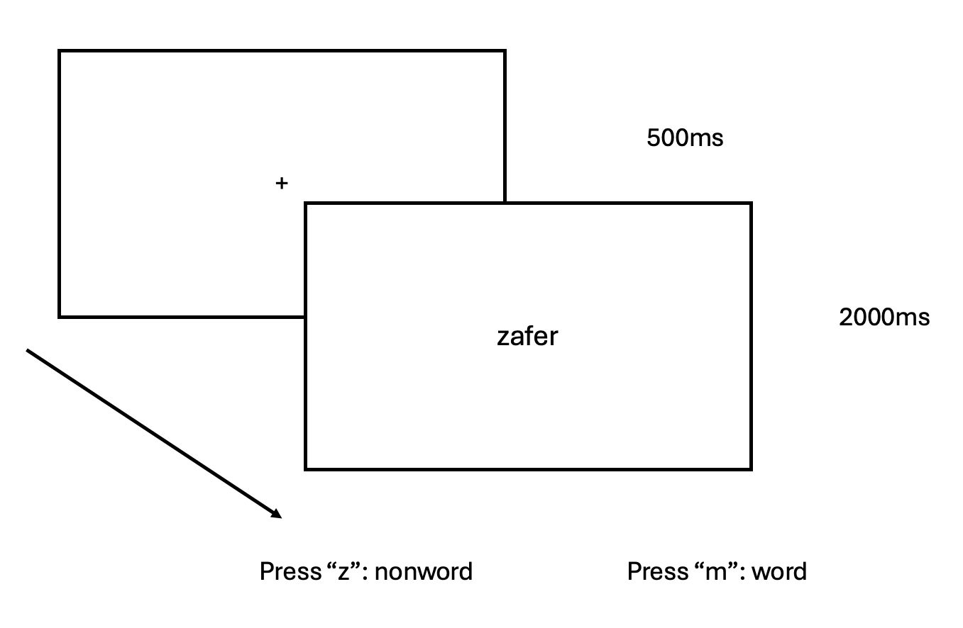
Experiment 1 Vowel harmony for words
𐰽𐰑𐰯𐰖𐰴𐰽𐰯𐰽𐰑𐰴𐰖𐰣𐰯𐰽𐰑𐰯𐰴𐰯𐰖𐰍𐰣𐰺𐰤𐰀𐰀𐰆𐰣𐰋𐰀𐰾𐰓𐰯𐰚𐰾𐰘𐰏𐰦𐰯𐰠𐰚𐰏𐰾𐰚𐰾𐰯𐰯𐰴𐰯𐰀𐰠𐱁𐰴𐰀𐰠𐰇𐰀𐰯𐰯𐰚𐰴𐰆𐰞𐰀𐱁𐰾𐰇𐰠𐰯𐰀𐰚𐰯𐰆𐰴𐰍𐰀𐰞𐱁𐰾𐰀𐰢𐰯𐰚𐰡𐰯𐰚𐰏𐰚𐰢𐰓𐰯𐰚𐰚𐰏𐰯𐰓𐰚𐰓𐰚𐰼𐰘𐰏𐰤𐰀𐰠𐰚𐰤𐰀𐰼𐰚𐰲𐰋𐰢𐰍𐰃𐰀𐰺𐰆𐰉𐰲𐰴𐱃𐰉𐰆𐰃𐰺𐰏𐰀𐰘𐰚𐰍𐰃𐱃𐰆𐰆𐰀𐰯𐰘𐰚𐰠𐰤𐰚𐰼𐰏𐰴𐰃𐰞𐰖𐰴𐰆𐰀𐰯𐰖𐰆𐰞𐰴𐰭𐰺𐰴𐰃𐰴𐰞3𐰆𐰆𐰼𐰀𐰴𐰘𐰠𐰚𐰢𐰯𐰤𐰏𐰼𐰴𐰃𐰖𐰴𐰆𐰆𐰀𐰴𐰘𐰠𐰯𐰚𐰤𐰴𐰃𐰺𐱃𐰆𐰆𐰀𐰘𐰠𐰯
Lexical decision task.
Implemented in PsychoPy (Peirce et al., 2019), and conducted online using the Pavlovia server.
The analyses were conducted using Bayesian linear mixed-effects models.
Notes:
We used lexical decision task in online settings by pavlovia and psychopy. We analyse our data with bayesian linear mixed effect model.

Slide 14
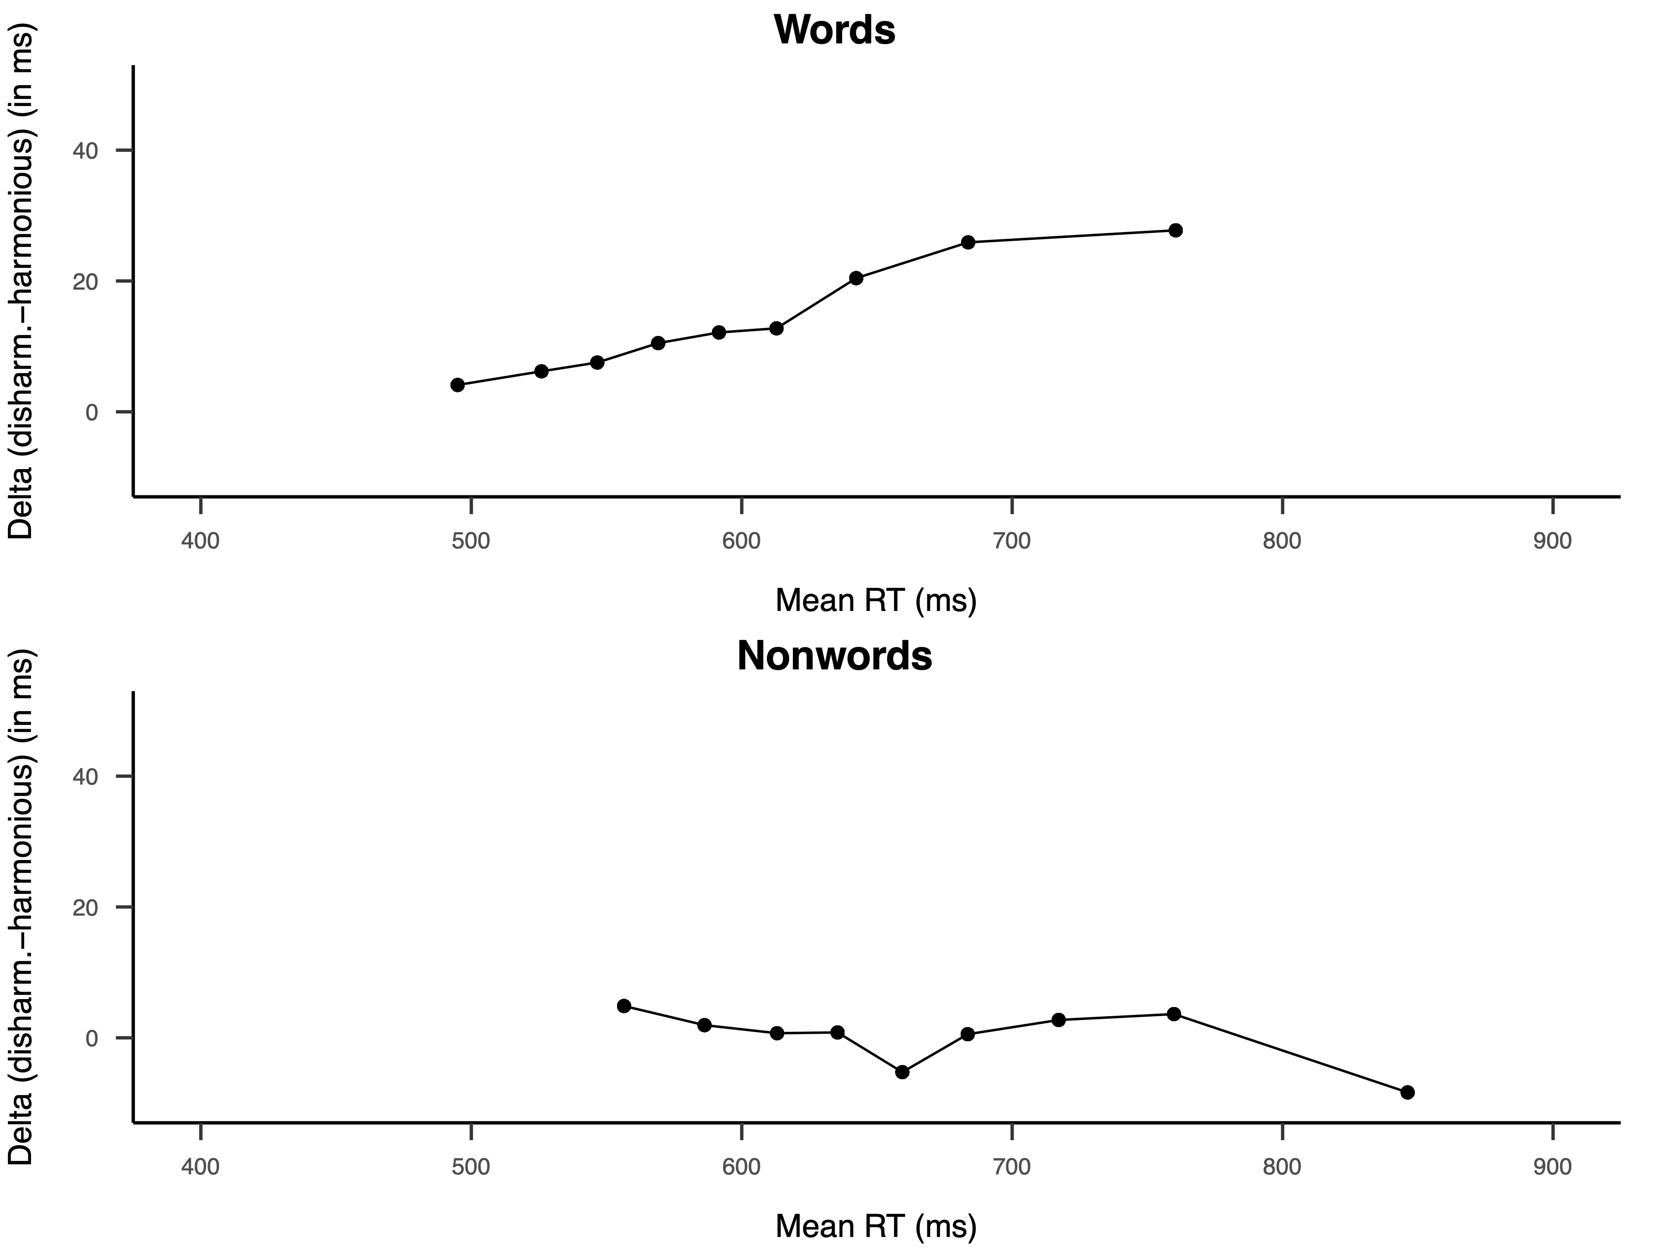
Experiment 1
𐰽𐰑𐰯𐰖𐰴𐰽𐰯𐰽𐰑𐰴𐰖𐰣𐰯𐰽𐰑𐰯𐰴𐰯𐰖𐰍𐰣𐰺𐰤𐰀𐰀𐰆𐰣𐰋𐰀𐰾𐰓𐰯𐰚𐰾𐰘𐰏𐰦𐰯𐰠𐰚𐰏𐰾𐰚𐰾𐰯𐰯𐰴𐰯𐰀𐰠𐱁𐰴𐰀𐰠𐰇𐰀𐰯𐰯𐰚𐰴𐰆𐰞𐰀𐱁𐰾𐰇𐰠𐰯𐰀𐰚𐰯𐰆𐰴𐰍𐰀𐰞𐱁𐰾𐰀𐰢𐰯𐰚𐰡𐰯𐰚𐰏𐰚𐰢𐰓𐰯𐰚𐰚𐰏𐰯𐰓𐰚𐰓𐰚𐰼𐰘𐰏𐰤𐰀𐰠𐰚𐰤𐰀𐰼𐰚𐰲𐰋𐰢𐰍𐰃𐰀𐰺𐰆𐰉𐰲𐰴𐱃𐰉𐰆𐰃𐰺𐰏𐰀𐰘𐰚𐰍𐰃𐱃𐰆𐰆𐰀𐰯𐰘𐰚𐰠𐰤𐰚𐰼𐰏𐰴𐰃𐰞𐰖𐰴𐰆𐰀𐰯𐰖𐰆𐰞𐰴𐰭𐰺𐰴𐰃𐰴𐰞3𐰆𐰆𐰼𐰀𐰴𐰘𐰠𐰚𐰢𐰯𐰤𐰏𐰼𐰴𐰃𐰖𐰴𐰆𐰆𐰀𐰴𐰘𐰠𐰯𐰚𐰤𐰴𐰃𐰺𐱃𐰆𐰆𐰀𐰘𐰠𐰯
Means
Delta plots
 |  |  | RT | Accuracy
Word
 | Harmonious | Harmonious | 604 | 0.974
 | Disharmonious | Disharmonious | 623 | 0.973
Pseudoword
 | Harmonious | Harmonious | 685 | 0.946
 | Disharmonious | Disharmonious | 686 | 0.943
As expected, harmonious words produced faster responses than disharmonious words. However, there was no effect of VH for pseudowords.
Notes:
Here you can see our means and delta plots. As expected, harmonious words produced faster responses than disharmonious words. However, for pseudowords, we didn’t get any effect and this null effect differs from the experiment in Finnish that I mentioned earlier. We design a second experiment 2 to solve this discrepancy.

Slide 15
Experiment 2 Solving the apparent discrepancy for pseudowords
𐰽𐰑𐰯𐰖𐰴𐰽𐰯𐰽𐰑𐰴𐰖𐰣𐰯𐰽𐰑𐰯𐰴𐰯𐰖𐰍𐰣𐰺𐰤𐰀𐰀𐰆𐰣𐰋𐰀𐰾𐰓𐰯𐰚𐰾𐰘𐰏𐰦𐰯𐰠𐰚𐰏𐰾𐰚𐰾𐰯𐰯𐰴𐰯𐰀𐰠𐱁𐰴𐰀𐰠𐰇𐰀𐰯𐰯𐰚𐰴𐰆𐰞𐰀𐱁𐰾𐰇𐰠𐰯𐰀𐰚𐰯𐰆𐰴𐰍𐰀𐰞𐱁𐰾𐰀𐰢𐰯𐰚𐰡𐰯𐰚𐰏𐰚𐰢𐰓𐰯𐰚𐰚𐰏𐰯𐰓𐰚𐰓𐰚𐰼𐰘𐰏𐰤𐰀𐰠𐰚𐰤𐰀𐰼𐰚𐰲𐰋𐰢𐰍𐰃𐰀𐰺𐰆𐰉𐰲𐰴𐱃𐰉𐰆𐰃𐰺𐰏𐰀𐰘𐰚𐰍𐰃𐱃𐰆𐰆𐰀𐰯𐰘𐰚𐰠𐰤𐰚𐰼𐰏𐰴𐰃𐰞𐰖𐰴𐰆𐰀𐰯𐰖𐰆𐰞𐰴𐰭𐰺𐰴𐰃𐰴𐰞3𐰆𐰆𐰼𐰀𐰴𐰘𐰠𐰚𐰢𐰯𐰤𐰏𐰼𐰴𐰃𐰖𐰴𐰆𐰆𐰀𐰴𐰘𐰠𐰯𐰚𐰤𐰴𐰃𐰺𐱃𐰆𐰆𐰀𐰘𐰠𐰯
Option 1: In the Finnish experiment of Perea et al. (2022), words were always harmonious. Thus, any item that was not harmonious was a nonword, which could have induced faster RTs for disharmonious pseudowords.
Option 2: Vowel harmony is less crucial for Turkish (around 25% of words are disharmonious) than Finnish readers, so it is a less salient marker for “nonword" responses.
To tell apart these two explanations, we designed Experiment 2
Notes:
There can be two potential reasons for this apparent discrepancy. One option is in the Finnish experiment words were always harmonious. So any disharmonious item should be a nonword. However we had half harmonious and half disharmonious words in our item list.
Second option is, as Turkish has more disharmonious words in its corpus than Finnish, maybe vowel harmony is a less salient marker for nonword responses.
To tell apart these two explanations, we designed Experiment 2

Slide 16
Experiment 2 Vowel harmony for pseudowords
𐰽𐰑𐰯𐰖𐰴𐰽𐰯𐰽𐰑𐰴𐰖𐰣𐰯𐰽𐰑𐰯𐰴𐰯𐰖𐰍𐰣𐰺𐰤𐰀𐰀𐰆𐰣𐰋𐰀𐰾𐰓𐰯𐰚𐰾𐰘𐰏𐰦𐰯𐰠𐰚𐰏𐰾𐰚𐰾𐰯𐰯𐰴𐰯𐰀𐰠𐱁𐰴𐰀𐰠𐰇𐰀𐰯𐰯𐰚𐰴𐰆𐰞𐰀𐱁𐰾𐰇𐰠𐰯𐰀𐰚𐰯𐰆𐰴𐰍𐰀𐰞𐱁𐰾𐰀𐰢𐰯𐰚𐰡𐰯𐰚𐰏𐰚𐰢𐰓𐰯𐰚𐰚𐰏𐰯𐰓𐰚𐰓𐰚𐰼𐰘𐰏𐰤𐰀𐰠𐰚𐰤𐰀𐰼𐰚𐰲𐰋𐰢𐰍𐰃𐰀𐰺𐰆𐰉𐰲𐰴𐱃𐰉𐰆𐰃𐰺𐰏𐰀𐰘𐰚𐰍𐰃𐱃𐰆𐰆𐰀𐰯𐰘𐰚𐰠𐰤𐰚𐰼𐰏𐰴𐰃𐰞𐰖𐰴𐰆𐰀𐰯𐰖𐰆𐰞𐰴𐰭𐰺𐰴𐰃𐰴𐰞3𐰆𐰆𐰼𐰀𐰴𐰘𐰠𐰚𐰢𐰯𐰤𐰏𐰼𐰴𐰃𐰖𐰴𐰆𐰆𐰀𐰴𐰘𐰠𐰯𐰚𐰤𐰴𐰃𐰺𐱃𐰆𐰆𐰀𐰘𐰠𐰯
We replaced the 71 disharmonious nouns with similar-frequency harmonious nouns from the same corpus. This way, all words were harmonious.
The pseudowords were the same as in Experiment 1.
A new sample of thirty-six Turkish participants participated (M = 26.94 y.o.).
All procedures and data analyses are the same as in Experiment 1.
The experiment was pre-registered in OSF.

Slide 17
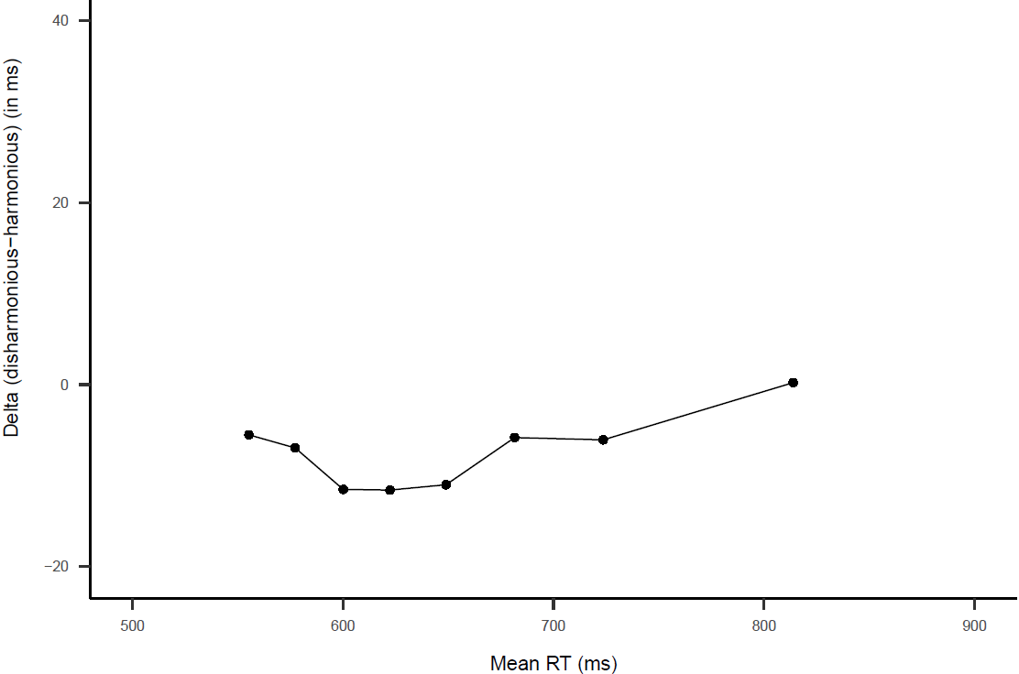
Experiment 2
𐰽𐰑𐰯𐰖𐰴𐰽𐰯𐰽𐰑𐰴𐰖𐰣𐰯𐰽𐰑𐰯𐰴𐰯𐰖𐰍𐰣𐰺𐰤𐰀𐰀𐰆𐰣𐰋𐰀𐰾𐰓𐰯𐰚𐰾𐰘𐰏𐰦𐰯𐰠𐰚𐰏𐰾𐰚𐰾𐰯𐰯𐰴𐰯𐰀𐰠𐱁𐰴𐰀𐰠𐰇𐰀𐰯𐰯𐰚𐰴𐰆𐰞𐰀𐱁𐰾𐰇𐰠𐰯𐰀𐰚𐰯𐰆𐰴𐰍𐰀𐰞𐱁𐰾𐰀𐰢𐰯𐰚𐰡𐰯𐰚𐰏𐰚𐰢𐰓𐰯𐰚𐰚𐰏𐰯𐰓𐰚𐰓𐰚𐰼𐰘𐰏𐰤𐰀𐰠𐰚𐰤𐰀𐰼𐰚𐰲𐰋𐰢𐰍𐰃𐰀𐰺𐰆𐰉𐰲𐰴𐱃𐰉𐰆𐰃𐰺𐰏𐰀𐰘𐰚𐰍𐰃𐱃𐰆𐰆𐰀𐰯𐰘𐰚𐰠𐰤𐰚𐰼𐰏𐰴𐰃𐰞𐰖𐰴𐰆𐰀𐰯𐰖𐰆𐰞𐰴𐰭𐰺𐰴𐰃𐰴𐰞3𐰆𐰆𐰼𐰀𐰴𐰘𐰠𐰚𐰢𐰯𐰤𐰏𐰼𐰴𐰃𐰖𐰴𐰆𐰆𐰀𐰴𐰘𐰠𐰯𐰚𐰤𐰴𐰃𐰺𐱃𐰆𐰆𐰀𐰘𐰠𐰯
Delta plot
Means
Nonwords
 |  | RT | Accuracy
Pseudoword
 | Harmonious | 658 | 0.955
 | Disharmonious | 652 | 0.957
Words: 581 ms, 0.955
We found evidence for a small but reliable effect of vowel harmony (b = 5.72, 95%CrI [0.25, 14.14]): RTs were faster for disharmonious than harmonious pseudowords—the same direction as in the cited experiment in Finnish.
Notes:
We found evidence for a small but reliable effect of vowel harmony. Disharmonic nonwords produced faster reaction time than harmonics. However its important to note that this effect size much smaller than in Finnish.

Slide 18
Conclusions
𐰽𐰑𐰯𐰖𐰴𐰽𐰯𐰽𐰑𐰴𐰖𐰣𐰯𐰽𐰑𐰯𐰴𐰯𐰖𐰍𐰣𐰺𐰤𐰀𐰀𐰆𐰣𐰋𐰀𐰾𐰓𐰯𐰚𐰾𐰘𐰏𐰦𐰯𐰠𐰚𐰏𐰾𐰚𐰾𐰯𐰯𐰴𐰯𐰀𐰠𐱁𐰴𐰀𐰠𐰇𐰀𐰯𐰯𐰚𐰴𐰆𐰞𐰀𐱁𐰾𐰇𐰠𐰯𐰀𐰚𐰯𐰆𐰴𐰍𐰀𐰞𐱁𐰾𐰀𐰢𐰯𐰚𐰡𐰯𐰚𐰏𐰚𐰢𐰓𐰯𐰚𐰚𐰏𐰯𐰓𐰚𐰓𐰚𐰼𐰘𐰏𐰤𐰀𐰠𐰚𐰤𐰀𐰼𐰚𐰲𐰋𐰢𐰍𐰃𐰀𐰺𐰆𐰉𐰲𐰴𐱃𐰉𐰆𐰃𐰺𐰏𐰀𐰘𐰚𐰍𐰃𐱃𐰆𐰆𐰀𐰯𐰘𐰚𐰠𐰤𐰚𐰼𐰏𐰴𐰃𐰞𐰖𐰴𐰆𐰀𐰯𐰖𐰆𐰞𐰴𐰭𐰺𐰴𐰃𐰴𐰞3𐰆𐰆𐰼𐰀𐰴𐰘𐰠𐰚𐰢𐰯𐰤𐰏𐰼𐰴𐰃𐰖𐰴𐰆𐰆𐰀𐰴𐰘𐰠𐰯𐰚𐰤𐰴𐰃𐰺𐱃𐰆𐰆𐰀𐰘𐰠𐰯
1) This is the first demonstration of a facilitative effect of vowel harmony on the identification of visually presented words.
2) This finding is consistent with the idea that vowel harmony helps to create a stable phonological code (global coherence hypothesis) during lexical access.
3) Unlike Finnish, vowel harmony only plays a very small role in “no” responses in lexical decision in Turkish, most likely because vowel disharmony is not a reliable marker of nonword-likeness.
Next step: Examining the effects of vowel harmony in a more “ecological” situation, during silent reading.
Notes:
In summary, this study is the first demonstration of the facilitative effect of vowel harmony on the word recognition of visually presented words. Our findings were consistent with the global coherence theory. Its important to note that vowel harmony plays a smaller role in nonword responses than Finnish.
The design is matter. But its not a critical criterion.

Slide 19
! 𐱅𐰀𐱁𐰚𐰚𐰇𐰼𐰠𐰀𐰼
𐰽𐰑𐰯𐰖𐰴𐰽𐰯𐰽𐰑𐰴𐰖𐰣𐰯𐰽𐰑𐰯𐰴𐰯𐰖𐰍𐰣𐰺𐰤𐰀𐰀𐰆𐰣𐰋𐰀𐰾𐰓𐰯𐰚𐰾𐰘𐰏𐰦𐰯𐰠𐰚𐰏𐰾𐰚𐰾𐰯𐰯𐰴𐰯𐰀𐰠𐱁𐰴𐰀𐰠𐰇𐰀𐰯𐰯𐰚𐰴𐰆𐰞𐰀𐱁𐰾𐰇𐰠𐰯𐰀𐰚𐰯𐰆𐰴𐰍𐰀𐰞𐱁𐰾𐰀𐰢𐰯𐰚𐰡𐰯𐰚𐰏𐰚𐰢𐰓𐰯𐰚𐰚𐰏𐰯𐰓𐰚𐰓𐰚𐰼𐰘𐰏𐰤𐰀𐰠𐰚𐰤𐰀𐰼𐰚𐰲𐰋𐰢𐰍𐰃𐰀𐰺𐰆𐰉𐰲𐰴𐱃𐰉𐰆𐰃𐰺𐰏𐰀𐰘𐰚𐰍𐰃𐱃𐰆𐰆𐰀𐰯𐰘𐰚𐰠𐰤𐰚𐰼𐰏𐰴𐰃𐰞𐰖𐰴𐰆𐰀𐰯𐰖𐰆𐰞𐰴𐰭𐰺𐰴𐰃𐰴𐰞3𐰆𐰆𐰼𐰀𐰴𐰘𐰠𐰚𐰢𐰯𐰤𐰏𐰼𐰴𐰃𐰖𐰴𐰆𐰆𐰀𐰴𐰘𐰠𐰯𐰚𐰤𐰴𐰃𐰺𐱃𐰆𐰆𐰀𐰘𐰠𐰯

